Slide 1
ORD COVID-19 Research Update for VHA Partners
Carolyn Clancy, MD
Rachel Ramoni, DMD, ScD
October 15, 2020

Slide 2
OPENING COMMENTS FROM
DR. CAROLYN CLANCY
ASSISTANT UNDERSECRETARY FOR HEALTH
DISCOVERY, EDUCATION AND AFFILIATE NETWORKS (DEAN)

Slide 3
RACHEL RAMONI, DMD, SCD
CHIEF RESEARCH AND DEVELOPMENT OFFICER

Slide 4
Alone we can do so little; together we can do so much. – Helen Keller
This Photo by Unknown Author is licensed under CC BY-SA

Slide 5
We are the largest integrated healthcare system in the nation.
We are affiliated with the top academic medical centers in the country.
We have clinicians and researchers who are professors at those medical centers.
As an enterprise, we are America’s Learning Healthcare System.

Slide 6
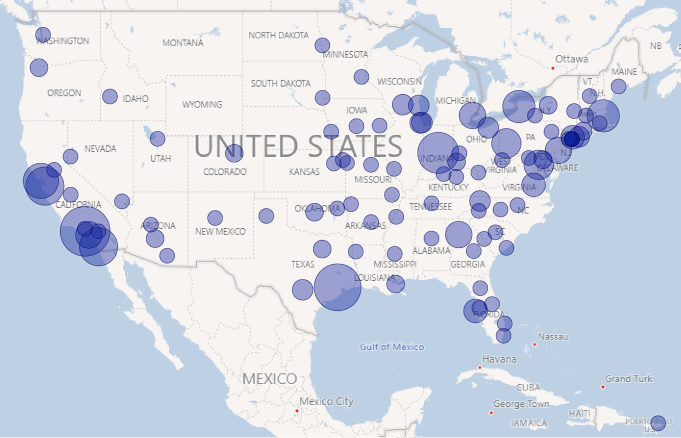
VA RESEARCH HEAT MAP

Slide 7
FEATURES OF AN ENTERPRISE
Communications
Shared Priorities
Core infrastructure and capabilities
Standardized processes
Ability to assess and improve the system
Prioritization of success of the whole over individual parts

Slide 8
COMMUNICATIONS & SHARED PRIORITIES
Thank you for your partnership!
Provide an overview of:
COVID-19 research studies
resources
new capabilities
Provide a preview of what’s to come
Look forward to continued partnerships for future challenges
Remind you of ordcovid19@va.gov, where you can write if you have questions for or need a hand from research.

Slide 9
IT HELPS WHEN WE KNOW EACH OTHER
Rachel Ramoni, DMD, ScD – Chief Research & Development Officer
Grant Huang, MPH, PhD – Dep. CRADO, Enterprise Optimization (Acting)
Vicky Davey, PhD, MPH – Assoc. CRADO, Epi. & Public Health
Molly Klote, MD – Director, Ofc of Research Protections, Policy & Educ.
Terri Gleason, PhD - Director, Clinical Science R&D
David Atkins, MD, MPH - Director, Health Services R&D
Sumitra Muralidhar, PhD – Director, Million Veteran Program (MVP)
Holly Krull, PhD – Deputy Director, Biomedical Lab R&D
Patricia A. Dorn, PhD – Director, Rehabilitation R&D
Email: ORDCOVID19@VA.gov

Slide 10
WHAT DO WE DO?
Rachel Ramoni, DMD, ScD
Grant Huang, MPH, PHD
Operation Warp Speed
Trials
VA Clinical Studies
Analytics / Impact
Biospecimens
Vaccines
Grant Huang
Thera-peutics
Vicky Davey
Thera-peutics
&
Prophylaxis
Terri Gleason
Observa- tional
Grant Huang
Data
David Atkins
Genomics
Suma Muralidhar
Bioreposi-tory
Holly Krull
Recruitment / Regulatory
Molly Klote

Slide 11
Grant Huang, MPH, PhD Vicky Davey, PhD, MPH Molly KLOTE, MD
OPERATION WARP SPEED (OWS)

Slide 12
OPERATION WARP SPEED (OWS)
OWS is swiftly implementing a series of vaccine and therapeutic trials
Therapeutics trials involve OWS-NIH effort called Accelerating COVID-19 Therapeutic Interventions and Vaccines (ACTIV)
antivirals, monoclonal antibodies, immunomodulators, anticoagulants
OWS Leads - Drs. Robert Kadlec, Matthew Hepburn (vaccines), Janet Woodcock (therapeutics)
Meeting with EIC on Sept 30
VA is considered Tier 1 network for these trials – high-level capabilities, experience and organization

Slide 13
ORD PARTNERED RESEARCH PROGRAM
Generated from Access to Clinical Trials Initiative
Establish an organized national capability for VA to partner in high quality clinical trials
Efficient processes and capabilities for initiating clinical trials in VA health care system
Models for partnerships
Provide more Veterans and investigators with opportunities to participate in industry and federally sponsored clinical trials on novel therapies
Partnered Research Program:
Serves as the initial point of contact for external organizations interested in partnering with VA
Facilitate efficient study start up
Provide Veterans and VA clinician investigators with opportunities to contribute to studies of national impact
Launched – March 2020 (accelerated by COVID-19 pandemic)

Slide 14
BRINGING TRIALS TO VETERANS
Coordination Recruitment
Clinical insight Quality
Other Federal
Sponsors
Industry
Education
Reducing Barriers
Education
Reducing Barriers

Slide 15
VACCINE TRIALS
4 OWS Trials + 1 industry
Moderna / COVE – 1 site recruiting
AstraZeneca – 1 site recruitment soon
Janssen/ENSEMBLE – 17 sites – recruitment starting 10/19
Novavax – 2 sites selected
Pfizer – 1 site, recruitment period done
Frequent coordination with OWS, NIAID, IQVIA (contract research organization), Coronavirus Prevention Network

Slide 16
ENSEMBLE (Janssen) VACCINE TRIAL
Site Start Up
Site Initiation Visit
Drug Receipt Prep
Agreements
Staffing
Regulatory/safety approvals
Pharmacy
Labs
Space
In-person 2-day visit
Training required
Details forthcoming
Target to begin enrollment:
As soon as Oct 15
~ 100 steps involved: In Progress

Slide 17
VA COVID-19 RESEARCH REGISTRY https://www.va.gov/coronavirus-research
Please invite people to visit the website

Slide 18
Diversity and Inclusion Subcommittee – Oct 5 Kick Off
A major priority is to ensure sufficient representation from minority groups, specifically Black and Hispanic individuals.
Black and Hispanic populations are among the hardest hit from the COVID-19 pandemic
Vaccines and treatments should be effective for the communities that need it most.
Advisory subcommittee to National Research Advisory Council to help guide strategies
VADM Jerome M. Adams, M.D., M.P.H. – U.S. Surgeon General to provide opening comments
VHA Partners can help with raising awareness among patients, staff & clinicians of this need

Slide 19
Vicky Davey, PHD MPH
ACCELERATING COVID-19 THERAPEUTIC INTERVENTIONS AND VACCINES (ACTIV)

Slide 20
Background: Accelerating COVID-19 Therapeutic Interventions and Vaccines (ACTIV)
In a national assessment of trial networks by the USG, VA was defined early as a ‘tier one’ network for COVID-19 clinical trials
Veteran patient population—at risk
Research capability and experience
Under Operation Warp Speed, ACTIV is a U.S. government-led initiative on therapeutics for COVID-19
Studies are international partnerships between governments, academia, private sector
OWS therapeutics efforts led by Dr. Janet Woodcock, FDA, CDER
ACTIV studies led by Dr. Francis Collins, NIH Director
Broadly representative, cross-disciplinary leadership teams choose study PIs and investigational agents
Pace is fast

Slide 21
ACTIV Studies are ‘Master’ or Adaptive Protocols
Master or adaptive clinical trials designs allow investigational agents (in combination with standard-of-care) to be added and dropped during the same study
Efficient testing of new agents against control
New agents may be added while earlier agents run in parallel or exit for safety concerns, lack of efficacy, or futility
Standard of Care (SOC) may change over time based on changing evidence
When more than one agent is being tested concurrently participants can be randomly allocated across agents and placebo lower odds of receiving placebo and efficient use of a placebo group
Agent A
Agent B
Agent C
Placebo

Slide 22
Study | Description | Agent(s) | VA Sites? | Lead | Status
ACTIV-1 | Phase 3---Inpatient Master Protocol to study immune modulators in COVID+ patients | TNF-alpha inhibitor, CTLA-4, CCR2/CCR5 inhibitors | Not now; competes with other studies | NIH/NCATS | Preparing to enroll.
ACTIV-2 | Phase 3—Outpatient Master Protocol to study monoclonal antibodies and other therapies in COVID+ patients | Lilly neutralizing mAb vs. placebo | Yes—multiple sites | NIH/NIAID/Division of AIDS/AIDS Clinical Trials Group | Enrolling; 3 VA sites qualified--Bronx, Pittsburgh, Gainesville VAMCs. ~10 more in process
ACTIV-3 | Phase 3—Inpatient Master Protocol to study monoclonal antibodies and other therapies in COVID+ patients | Lilly neutralizing mAb vs. placebo | Yes—multiple sites | NIH/NIAID/ Division of Clinical Research and INSIGHT network | Paused on 10/13/20: 326 randomized, >40 sites, Miami, Houston and San Francisco VAMCs open. ~24 more in process.
ACTIV-4 | Phase 3—Master Protocol to study antithrombotic therapies in inpatient and outpatient COVID+ patients | Inpt: Proph vs. therapeutic heparin Outpt: Apixiban low or hi dose, ASA, placebo Post-discharge: Apixiban vs. placebo | TBD; VA sites approached | NHLBI/NINDS/BARDA | Enrolling
ACTIV-5 | Phase 3—Inpatient Master Protocol to study immune modulators, antivirals, and others for early large effects in COVID+ patients | Lenzilumab | TBD | NIAID | In development

Slide 23
Why ACTIV studies in VA?
Promise: perhaps, of treatments for COVID-19
Contribution: to the global effort
Access: for Veterans
Efficiency: multiple investigational agents tested
Opportunity: access to data and biospecimens
Collaboration: with international experts
Challenge: of a master, adaptive, platform protocol

Slide 24
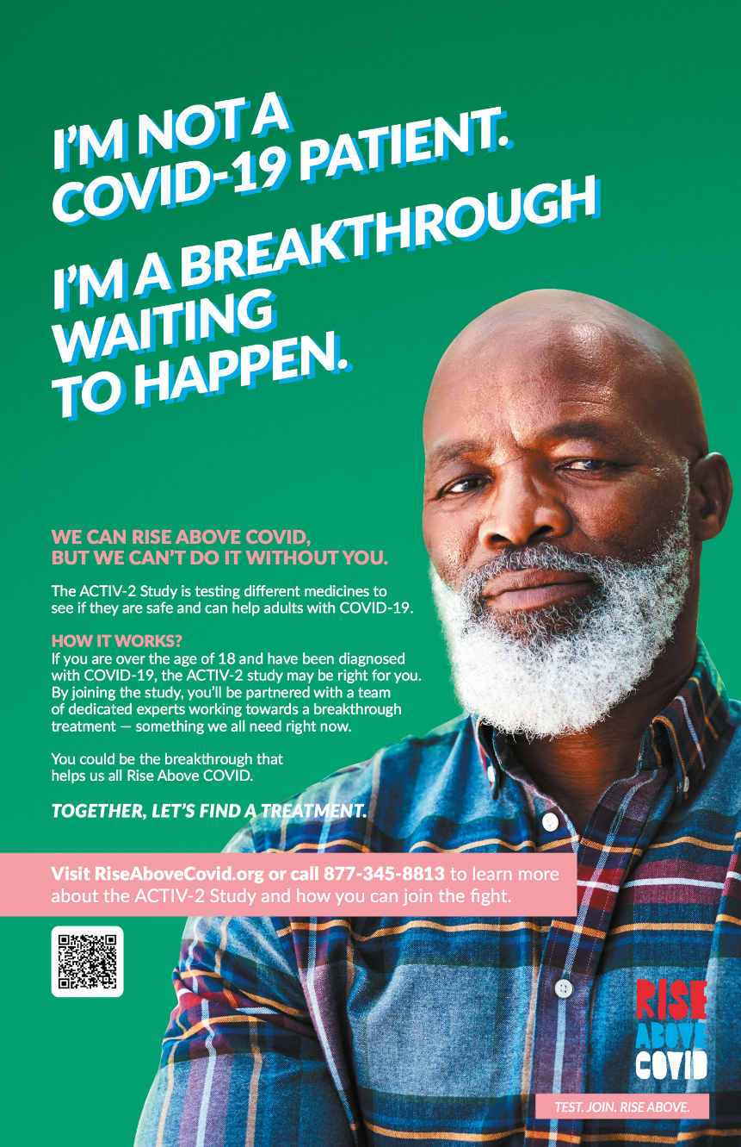
VA Partners – ACTIV trials
Veteran participants
VA investigators & study teams
Clinical staff who test, recruit, monitor, follow-up participants
Emergency Management
Assoc Chiefs of Staff/Research
VAMC directors and leaders
VISN directors and leaders
VA and VHA communications
OGC
POC for ACTIV trials:
Vicky Davey (victoria.davey@va.gov)

Slide 25
’S SLIDES
Research Protections, Policy & Education
Molly Klote, MD

Slide 26
Office of Research Protections, Policy and Education
Protections
Central Institutional Review Board (IRB)
Ethical review board for human subjects studies
Policy
Policy, Guidance, FAQs
https://www.research.va.gov/programs/orppe/default.cfm
Education
Searchable FAQs https://www.research.va.gov/resources/policies/faq-search.cfm
Toolboxes

Slide 27
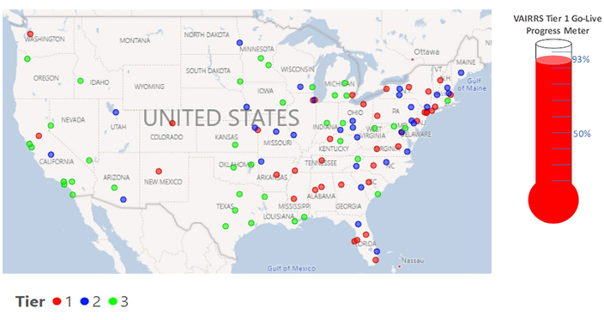
VA Innovation and Research Review System (VAIRRS)
Commercial Off the Shelf product
Committee Review Software product
Tracking actions across the enterprise
Office of Research Oversight
Research Support Division
Privacy
OGC
Publications
Quality Improvement projects
Innovation Projects
Agreements
Committees:
Administrative Review
Scientific Review
Determinations
IRB Review
IBC Review
R&DC Review
Central Privacy Board

Slide 28
Coming Attractions
VA Electronic Determination Aid (VAEDA)
Decision support tool for research/not research decisions
Engagement (redefined)
New interpretation of what it means to be engaged in a research study
Open opportunities for decentralized clinical trials
Clinical Trials Management System (CTMS)
Central platform for research data entry
Research Dashboards – Power BI
Use the data from VAIRRS and CTMS

Slide 29
Selected ORD Central Coordination Efforts
COVID-19 Research Registry and Call Center – to support COVID-19 study recruitment
VEO, CTO/US Digital Services/ORD/MVP/VHA Communications
Operational with >1200 registered
DocuSign Access for electronic consent and HIPAA Authorization
OI&T IAM Office
to support electronic record keeping
IMedConsentTM
National Center for Ethics in Health Care
Mobile Vet Centers for COVID-19 preventative trials (only)
Readjustment Counseling Service
Additional clinical/research space

Slide 30
HOLD FOR TERRI’S SLIDES
VA SPONSORED CLINICAL STUDIES
Terri Gleason, PhD

Slide 31
VA’s COVID-19 CLINICAL TRIALS
In addition to national OWS trials, ORD is also supporting clinical trials to determine safe and effective interventions across the therapeutic spectrum from prevention, mild/outpatient, severe/inpatient – and - including biospecimen collection protocol for future analyses
Several funding mechanisms are available for VA investigators to propose clinical trials, including our standing programs such as the VA Merit Review and CSP trials
A new, innovation focused on COVID-19 has also just been introduced: VA CURES Program is coordinating work via master protocols, starting with convalescent plasma trial for VA inpatients, and expanding to early prevention protocol, then outpatient protocol. Opportunities to present study ideas will be open soon.

Slide 32
VA Trials of Note: 1. HITCH
HITCH is examining safety and benefit of degarelix in patients hospitalized for COVID-19. Study is attempting to enroll 185 participants randomized to either study drug or matched placebo. Study drug is hypothesized to reduce the onslaught of further compromise particularly with respect to lung function and if successful should result in reduction of days on ventilator and death.
HITCH is active in 11 of 14 planned sites across the country. Challenges include reducing the patient contacts by research staff and others, the changing case load numbers (and hospitalization for non-COVID-19 conditions)

Slide 33
2. VA CURES-1
VA CURES-1 is tackling the important question of the benefit of convalescent plasma, which has been used in other infectious diseases and recently was used in a clinical protocol for COVID-19 patients (VA data is being analyzed)
VA CURES-1 will provide plasma or saline in a blinded fashion during administration to determine benefit in reducing need for ventilation and preventing death
With a focus on recruiting 702 participants from approximately 25 sites, this study will definitively answer whether convalescent plasma is effective in an RCT

Slide 34
Future Look and Feel of VA Clinical Trials
Prioritization of activity through extensive outreach and consultation: What is the most important question to answer first?
Seamless integration with affected program offices regarding trial implementation, from idea initiation and study design through the stages of moving findings into practice
Established infrastructure that promotes more sustainability at the local sites as well as increased efficiency through standardized approaches such as master protocols and integrated study teams

Slide 35
CSP 2028 - Epidemiology, Immunology and Clinical Characteristics of COVID-19 (EPIC³) within VHA
Partnership with Department of Defense
Aim 1: Identify patterns of SARS-CoV-2 viral shedding from multiple body sites in inpatient Veterans with COVID-19 infection during hospitalization through 28 days of follow-up.
Aim 2: Characterize development of immunity among inpatient and outpatient Veterans with COVID-19 from first VHA encounter though 24 months.
Aim 3: Determine predictors of infection and disease course, severity and related death among inpatient and outpatient Veterans with and without SARS-CoV-2 infection and/or COVID-19 disease over 24 months.
Aim 4: Determine individual and health-facility-level risk factors for infection (including asymptomatic infection) with SARS-CoV-2 among Veterans at high risk for COVID-19 disease who are living in VHA Community Living Centers.
Study Chairs: Jennifer Lee, MD (Palo Alto); Jennifer Ross, MD (Puget Sound)
CSP Coordinating Center: Seattle CSP Epidemiology Center (Nick Smith, PhD)

Slide 36
CSP 2028 / EPIC³
3 cohorts of Veterans
3,400 positive/negative inpatient
5,000 positive/negative outpatient
600 CLC
Up to 16 recruitment sites with 12 months of recruitment
Start: July 22, 2020
End: July 2021
24 months of follow-up
Study end date: September 30, 2024

Slide 37
David Atkins, MD, MPH
COVID-19 ANALYTICS AND IMPACTS

Slide 38
Health Services Research on the Impact of COVID
(Points of Contact follow Research Areas)
Rapid evidence Synthesis of Emerging Evidence – Nicole Floyd
Observational studies of medication treatments -- Alexandra Neuhaus-Follini
Rapid response projects – Emily Evans
Disparities in COVID Outcomes – Naomi Tomoyasu
Modeling Risk of Infection and Poor Outcomes – Miho Tanaka
COVID impacts on Veterans in Long Term Care – George Fitzelle
IN DEVELOPMENT – Impacts of the Pandemic on Care and Outcomes for Non-COVID Conditions –Stephanie Guerra

Slide 39
Evidence Synthesis Program (ESP)
Resource for Clinical and Operational Leadership to Support Decision-making for COVID-19
Ultra-Rapid Reviews & Living Reviews
Within 7-10 days of request of VA partners
8 completed (2 living reviews)
COVID-19: Intensive care unit length of stay and ventilation days
Critical Appraisal of New Research
Critical appraisal of individual high-priority studies, including pre-prints
6 completed:
PREPRINT REVIEW: Outcomes of hydroxychloroquine usage in COVID
COVID-19 Evidence Review Website
Developed in cooperation with WHO
Pulls from 15 international sources
Over 500 new reviews/protocols per month
Please let us know if you’d like to receive email notifications for reports in progress: covid19reviews@gmail.com

Slide 40
COVID Rapid Response Initiative
9-month funding for new projects or supplements
Reviewed 200 proposals over 2 rounds, funded 20
Examined wide range of outcomes related to COVID and to pandemic response
Mental health impacts
Direct clinical impacts (CKD, long-term effects, CLCs)
Disruptions in care (Chronic disease, CVD)
Health system (Nurse staffing, Occ Health planning)
Lay groundwork for longer-term studies

Slide 41
Studying COVID-19 Impacts on Mental Health (19 projects funded by HSRD, RRD and CSRD)
Populations at Risk
General Veteran Population
Veterans with MH Conditions (MDD, PTSD, Substance Use)
Other Vulnerable Populations (Aging, Homeless, Residential, Rural)
Clinical & Behavioral Outcomes*
Activities
Functioning
Family relationships
Mental Health Symptoms
Physical Health
Substance Use
*Potential relationships (and effects) among variables within this set.
C
COVID-19-related anxiety
COVID-19 Infection
Local COVID severity
Public Health Response
Restrictions (schools daycares, living facilities, business, travel)
Shelter in Place Measures
Social Distancing
Intermediate Outcomes*
Basic Needs (e.g., food, housing, income)
Medical Care (access, utilization, adherence)
Social Support (access to social services, community support & integration, social connectedness)
*Potential mediators or moderators of clinical/behavioral outcomes
Interventions to Address Mental Health
Both COVID-19 and
non-COVID-19 specific
Interventions to Address Medical, Social, and Economic Resource Needs

Slide 42
Collaboratory to Study Medication Effects
Grew out of work with FDA Evidence Accelerator Efforts
Using observational data from early treatment experience to identify good candidates for definitive drug trials vs. COVID-19
Hydroxychloroquine
Anti-coagulants
Transitioning to develop “real world evidence” on established treatments
Remdesivir
Steroids
Joined by “Data and Methods” Workgroup to review and improve study methods for COVID-19 research

Slide 43
Collaboratory For Observational Research on COVID-19
Grew out of FDA collaboration
Using data from early COVID-19 response

Slide 44
HOLD FOR SUMA’S SLIDES
GENOMICS AND COVID-19
Suma Muralidhar, PhD

Slide 45
The Million Veteran Program (MVP): A Partnership with Veterans
Largest healthcare system-based genomics research program in the world
Role of genetics, lifestyle and military exposure in health
Make VA data work for Veterans; Real-world impact
Surveys, blood sample, access to health records, agree to recontact
Centralized recruitment process
Coordinating Centers, Biorepository, Information Center
Outreach & Communications: Partner with VA, VHA, VAMC, VSOs and other stakeholders
Contracts for mail/scan; genomic analysis
Enrollment in-person at 60 VAMCs plus ~70 CBOCs
Enrollment On-Line (consent, HIPAA authorization, surveys)
Secure, central computing infrastructure bringing researchers to the data for scientific analysis; coded data only

Slide 46
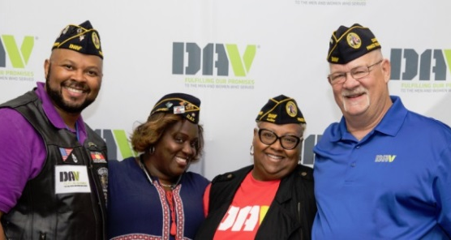
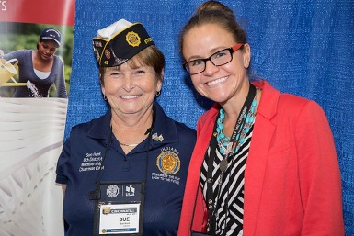
2011- Present: Milestones accomplished
Every sample genotyped
Deep molecular analysis on 100K
Ethnic-specific analysis
Phenomics library
33 funded studies
Translation of findings
200+ researchers
40+ VA and academic affiliates
Over 825,000 enrolled!
Racially and ethnically diverse cohort
Conference Abstracts | Manuscripts | Papers Published
>100 | >34 | 50

Slide 47
Contributions to COVID-19 Trials Infrastructure
Leveraged the MVP centralized recruitment and enrollment infrastructure and Outreach and Communications experience
Genisis database (all Veterans receiving healthcare at VA)
MVP Information Center (Call Center)
MVP On-Line portal
Emails to MVP enrollees about the COVID-19 Volunteer List (central registry)
# of volunteers spiked from ~100 to >1200 in 2 days
Program Office, Coordinating Center and Site Staff
Leveraging relationships with VA and VHA Program Offices, VAMCs, VSOs

Slide 48
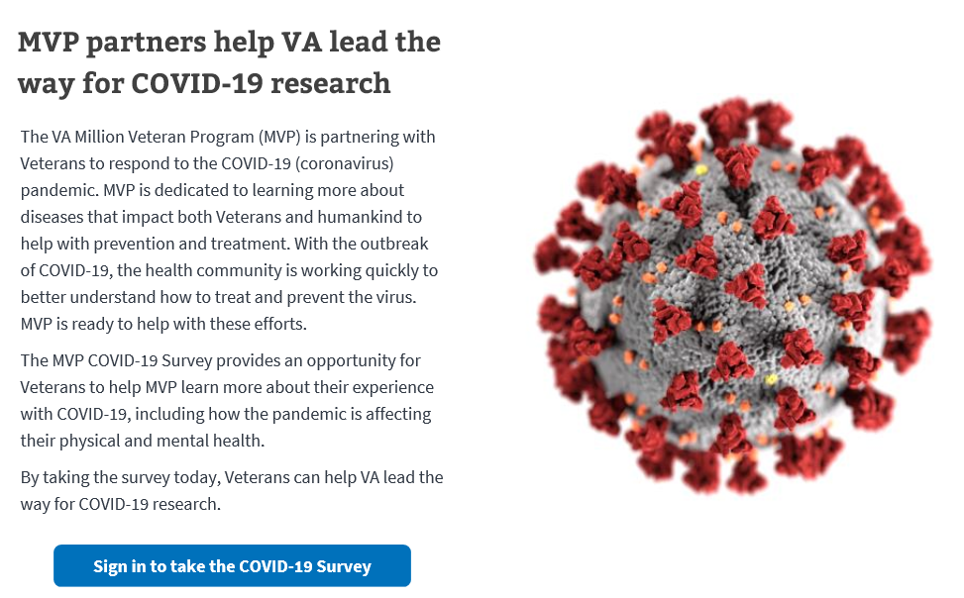
MVP COVID-19 Data Collection
~91K MVP participants tested for COVID-19 (VA) as of Sept 2020
6,800 positive
84,000 negative
MVP COVID-19 Survey
Distributed to all MVP participants; completion through mail/online
Total of 53,500 completed as of 10/13/20
Online respondents younger, female, white
Second round of mailed surveys to non-responders starting in October 2020

Slide 49
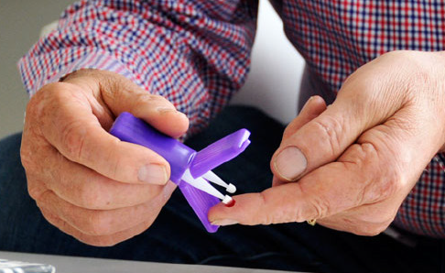
MVP Specimen Collection Pilot Activities
At-home blood collection pilot
Capillary technology
Testing for device feasibility
Usability/scalability
Coordination with Holodniy lab (Palo Alto) for processing and serologic testing
Mobile phlebotomy pilot
Examine feasibility of collecting blood specimens by sending third-party phlebotomists to homes
Goal to capture 3 separate specimens from COVID-19 persons of interest (over 9 months)

Slide 50
MVP COVID-19 Science: Host Genetic Contributions
Over 75 MVP researchers organized into 6 Working Groups with assigned data analysts
Genome-wide association analysis for susceptibility, severity and mortality
Partnering with the Global COVID-19 Host Genomics Initiative; potentially 23AndMe
Polygenic risk scores
Pharmacogenomics
Phenome-wide association analysis
Disease mechanisms
Druggable genome (discover new and re-purposable treatments)
First treatment trial concept developed
MVP POC: Suma Muralidhar- Sumitra.Muralidhar@va.gov

Slide 51
PATRICIA A. DORN, PhD
REHABILITATION RESEARCH

Slide 52
VHA Supply Chain & Rehabilitation-related COVID-19 Research
Nasal Swab Objective and Statistical Evaluation (NOSE) Study
ORD/IE Safety & Efficacy Study: PIs J. Iaquinto & B. Ripley
Goal, maintain supply chain within VHA
Produce swabs that are as good as what is commercially available
Produce swabs that when used to test for COVID-19 return results that indicate usability
Status, Scientific Review end of October
COVID-19 Special Emphasis Area in RR&D RFAs
Studies on impact of COVID-19 on Veterans’ physical, sensory, cognitive and psychosocial function by:
Understanding onset of, severity and duration, and recovery from disability in Veterans following COVID-19 that considers influence of comorbidities (e.g., pre-existing pulmonary, cardiometabolic, oncologic, mental health, immunological or other disorders, etc.), other risk factors (e.g., age, living conditions, environmental exposures, etc)
Revealing late or delayed effects of secondary conditions related to COVID-19 infections on impairment and disability
Examining COVID-19-specific rehabilitation interventions and responses to treatment
Determining impact of social distancing on functional status in healthy, disabled and at-risk Veterans (e.g., substance use and mental health disorders, homelessness)

Slide 53
Holly Krull, PhD
VA-ORD NATIONAL BIOSPECIMEN AND DATA REPOSITORY

Slide 54
VA-ORD National Biospecimen and Data Repository
The Biorepository system will be a
comprehensive repository of COVID-19 and other emerging diseases specimens and associated data available for research studies in order to advance scientific understanding of this disease and further diagnostic, therapeutic and prevention strategies for immediate deployment in clinical environments.
model repository for other diseases and conditions affecting veterans.
way to enhance collaboration with external partners focused on COVID-19 and other emerging infectious diseases research.
mechanism to harmonize specimen and data collection procedures across clinical sites.
way to launch flexible response to dynamic disease occurrences.

Slide 55
Guiding Principles
Maximize collection of high-quality specimens and data ethically and efficiently
Harness clinical and scientific strengths of the VA in order to create synergistic effects with pre-existing efforts
Leverage the administrative and regulatory capabilities of the VA to ensure accountability and compliance
Provide an effective mechanism to review, approve and distribute specimens and data to scientific partners

Slide 56
Specimen Collection
Two collection strategies
Save existing remainder clinical specimens.
Collect specimens for current and future research.
Collection characteristics
Multisite protocols, VA-CIRB reviewed
Allows current SARS-CoV-2 and COVID-19 specimen collection, but protocols not disease specific
Flexible storage location
Puts in place future specimen collection system for research, but specimens are not pre-dedicated to a project

Slide 57
Virtual Biorepository (LIMS)
General Principles:
Ability for Sample collection at multiple sites.
Sample storage at one or more central Biorepositories (as needed).
Laboratory Information Management System
Ensure chain of custody.
Manage accession of specimen, storage, and distribution.
Use of honest broker.

Slide 58
CONCLUSION
VA Research across a range of areas is critical to fighting COVID-19 to help our Veterans, providers and healthcare system
Efforts to date lay the foundation for an enterprise-wide approach that values partners in VHA/VA and external to system
ORD research is grateful for the extensive partnerships and looks forward to those accomplishments to come

Slide 59
VA Partners in COVID-19 Research
VA
VHA
Advisory Committee Management Office
Center for Minority Veterans
Center for Strategic Partnerships
Center for Women Veterans
Office of General Counsel / STAR
Office of Information Technology
Digital Services
Identity and Access Management
Research Support Division
Office of Public and Intergovernmental Affairs
Center for Faith and Opportunity Initiative
National Veterans Outreach Office
Office of Tribal Government Relations
Veterans Experience Office
Assistant Deputy USH for Clinical Operations
Innovation Ecosystem
National Center for Ethics in Health Care
National Biosurveillance Taskforce
Office of Communications
Office of Community Engagement
Office of Finance
Office of Health Equity
Office of Nursing Services
Office of Patient Care Services
National Center for Health Promotion and Disease Prevention
National Chaplain Services
Pharmacy Benefits Management
Public Health
Specialty Care Services
Hospital Medicine
Pathology and Laboratory Service
Pulmonary and Critical Care Medicine
Office of Research Oversight
Office of Voluntary Services
Office of Workforce Management and Consulting
Privacy Office
Readjustment Counseling Service
THANK YOU!

